Slide 1
Retro Gear
Electronic Device Website
Isaac M Brown
10/10/2024

Slide 2

Section Title

Slide 3
Intro
Welcome to Retro Gear, a global proxy platform that facilitates connections between individuals and their preferred electronics retail sites. Our service allows users to buy, sell, and trade electronic devices with anyone, anywhere in the world, regardless of brand preference.

Slide 4
Website Details
Retro Gear's primary objective is to facilitate connections between consumers and retail platforms globally, enabling them to purchase electronic devices across various categories, such as televisions, mobile devices, wearables, computers, tablets, appliances, and more. Users have the option to sell their devices on the website to generate additional income or donate them to others. Additionally, users can engage in trade through the platform, allowing them to share their devices with interested recipients worldwide.
The website serves as a platform that links numerous retail stores globally, including Newegg, Walmart, Circuit City, Electronic Express, Target, and others, allowing users to navigate seamlessly among these options.

Slide 5







Retail Sites
Retail Sites for Retro Gears:
- Newegg
- Walmart
- Circuit City
- Electronic Express
- Target
- Micro Center
- Sears
- Best Buy
- Sony Electronics
- Amazon
- eBay

Slide 6
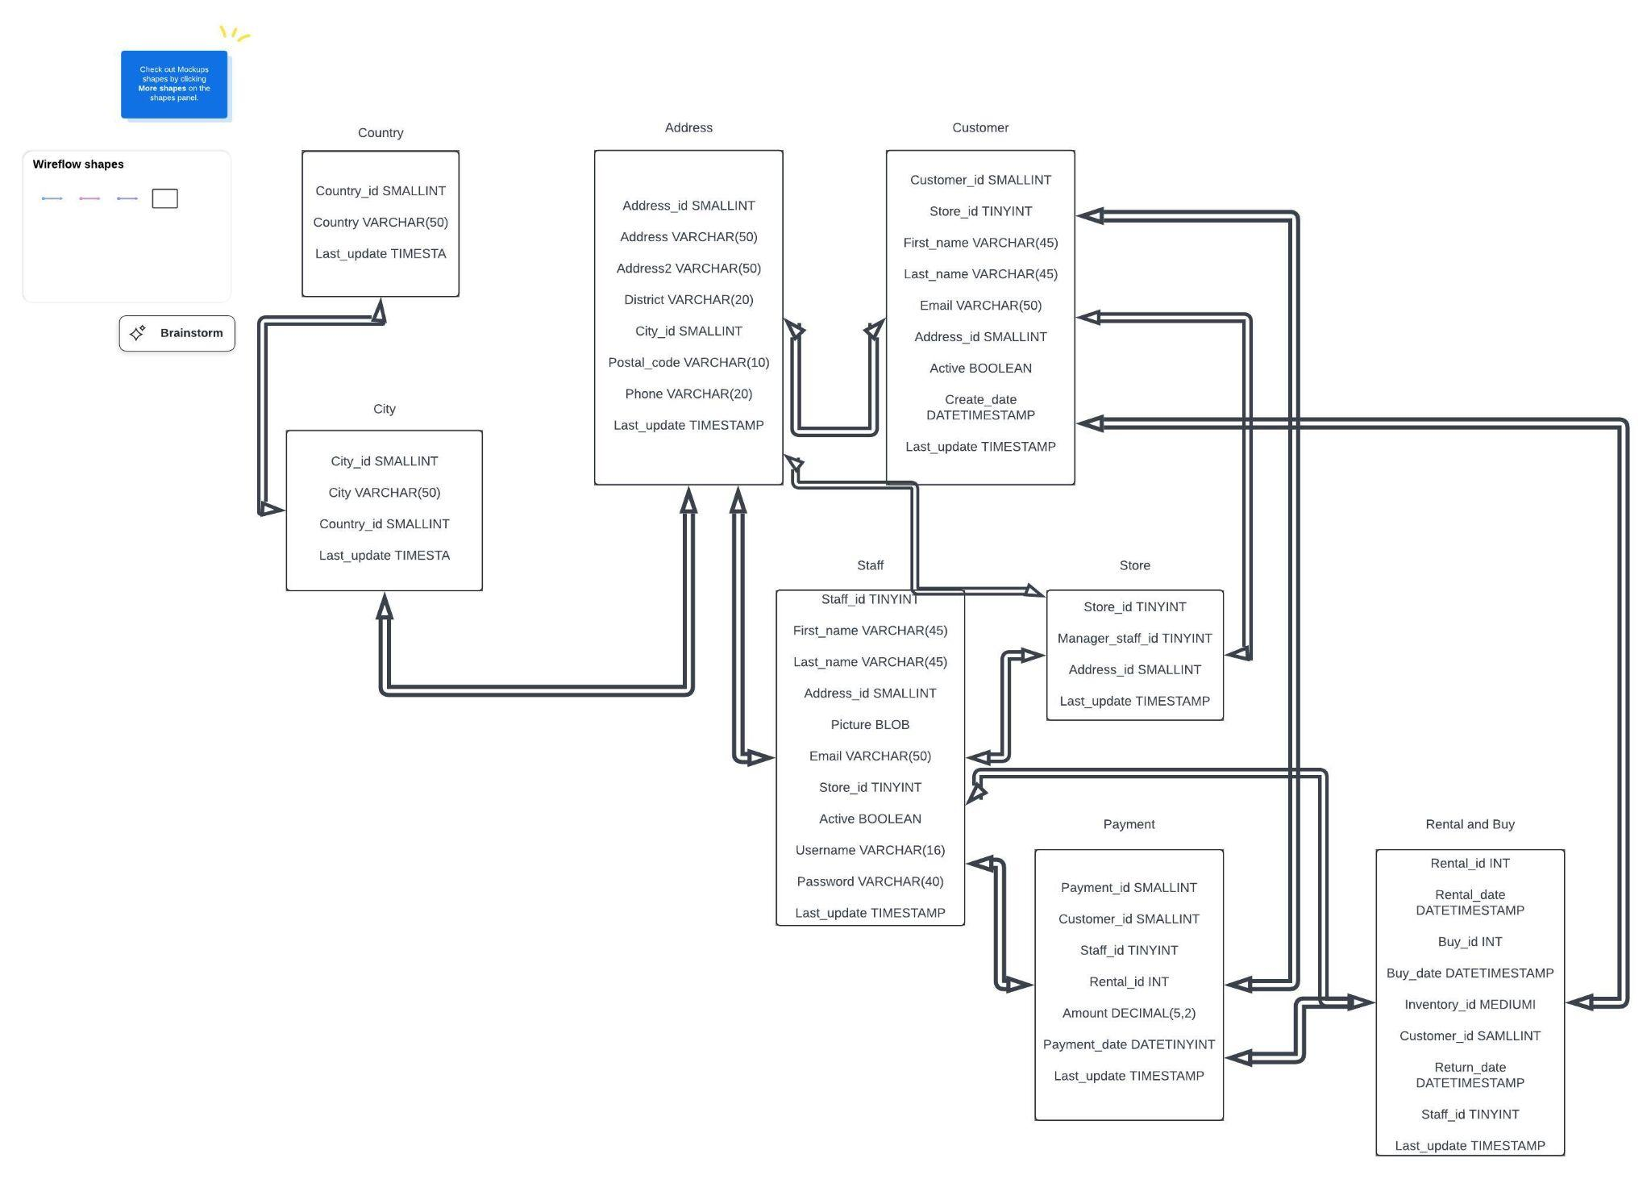
Retro Gears Flowchart

Slide 7
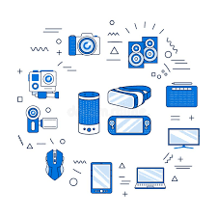
Our Slogan
“Retro Gear offers you a nostalgic experience with your devices”.

Slide 8
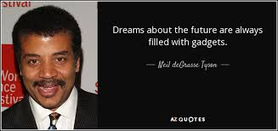

Slide 9
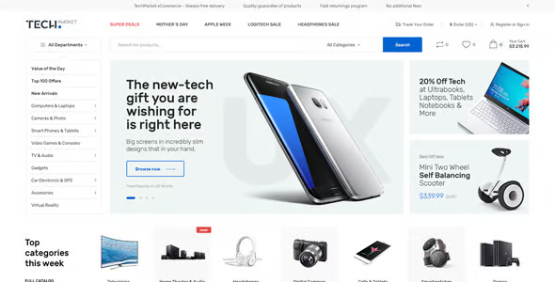

Thank You!
Contact us:
Retro Gear
3715 Abraham Lincoln ln,
San Antonio TX 78015
retrogear.com
www.Retro Gear.com

